Slide 1
Sinogram Denoising
Medical Imaging Project Presentation
Ashwin R Nair - 122101004
Siva KMR - 122101038

Slide 2
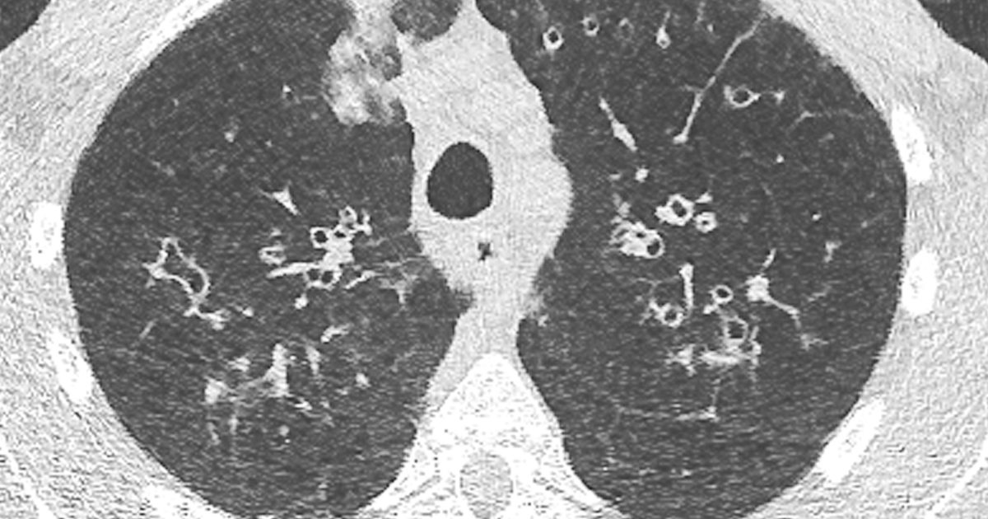
Problem Statement
Minimizing X-ray exposure to patients is a critical goal in CT imaging. However, low-dose CT protocols result in high noise levels in the sinogram, which degrades the quality of image reconstruction. To address this denoising challenge in the sinogram domain, we employ a neural network architecture.

Slide 3
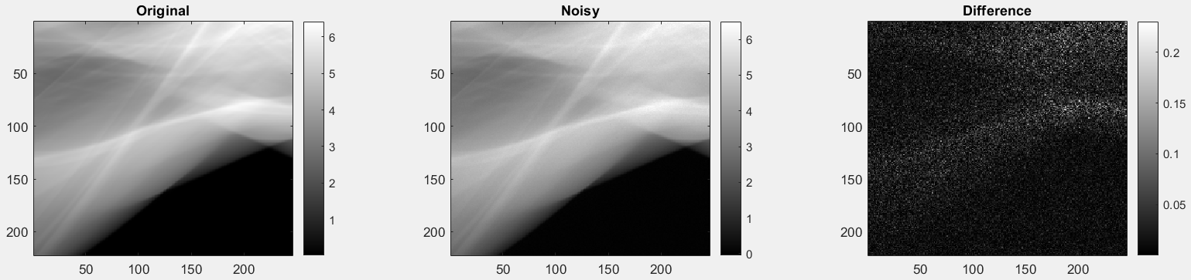
Data Generation
Poisson and gaussian noise was added to the original sinogram.
Both original and noisy sinogram was divided into 16 patches and plotted.
It was saved into a .h5 file to train the model.
407*16 = 6512 was the total size

Slide 4
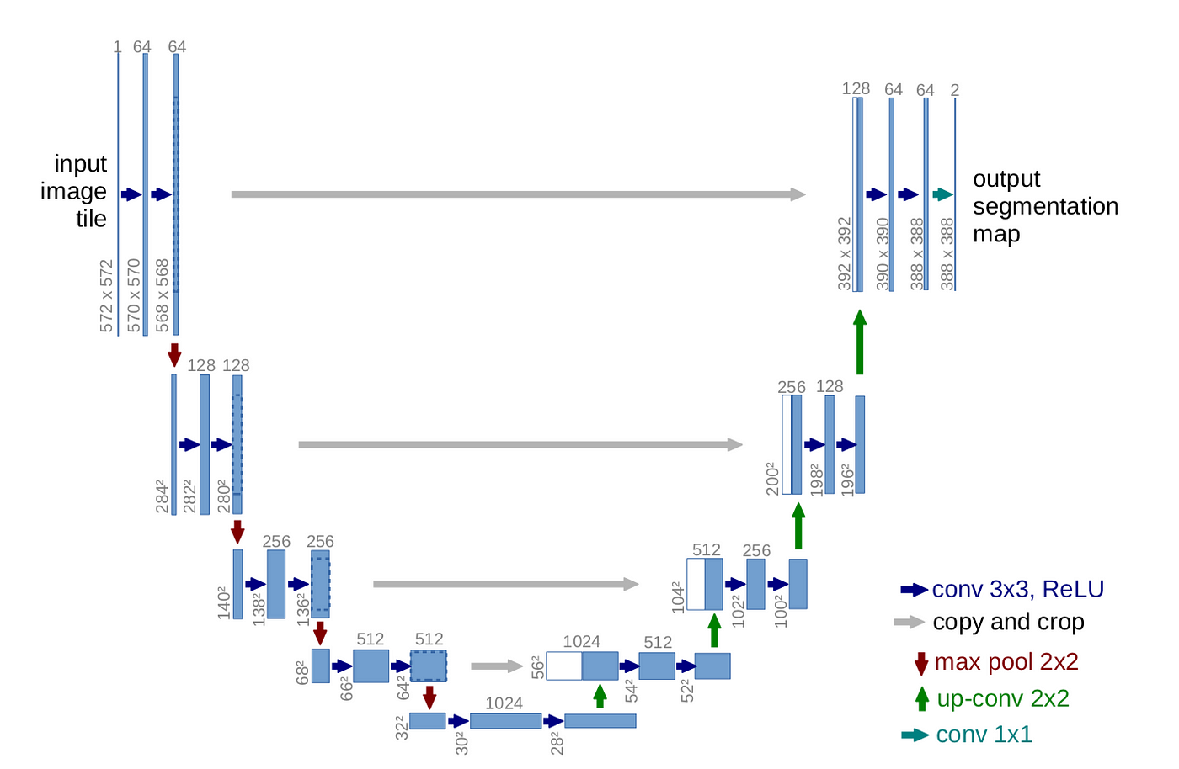
UNet Architecture
Convolutional layers with ReLU activation functions for feature extraction and downsampling is done through max-pooling in encoder and decoder.
Final convolutional layer produce the segmentation mask with 1 output channel.

Slide 5
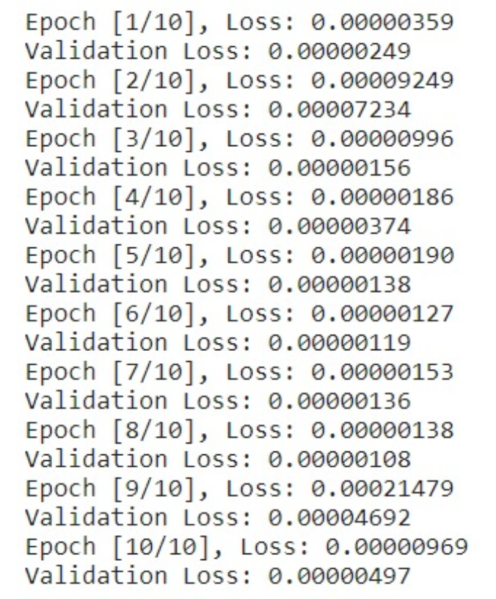
Training and Validation
Mean Squared Error (MSE) is the loss function. It helps the model to minimize the error between the predicted outputs and the actual targets.
We used Adam optimizer, which is an adaptive learning rate optimization algorithm. The initial learning rate is set to 0.001. (gamma = 0.1).
We have also used a learning rate scheduler that reduces the learning rate when MSE has stopped improving.
Training data size : 5210
Validation data size : 1302

Slide 6
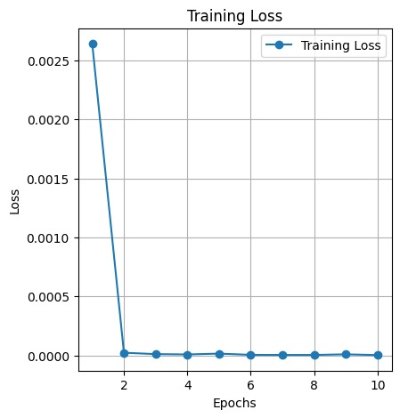
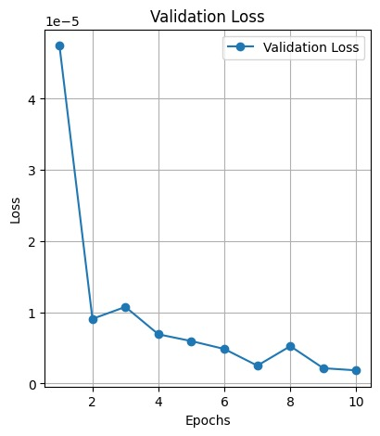
Training and Validation Loss

Slide 7
Results
Dataset from the .h5 file was taken and split into training (80%) and validation (20%) datasets.
After training the model, we created a code in which a noisy sinogram is divided into 16 pieces and fed into the model. The model returns the 16 pieces of denoised sinogram. It is then combined and compared with our noisy sinogram and difference is plotted.
We also reconstructed images from the clean sinogram, noisy sinogram and model processed sinogram and plotted the difference to compare.

Slide 8
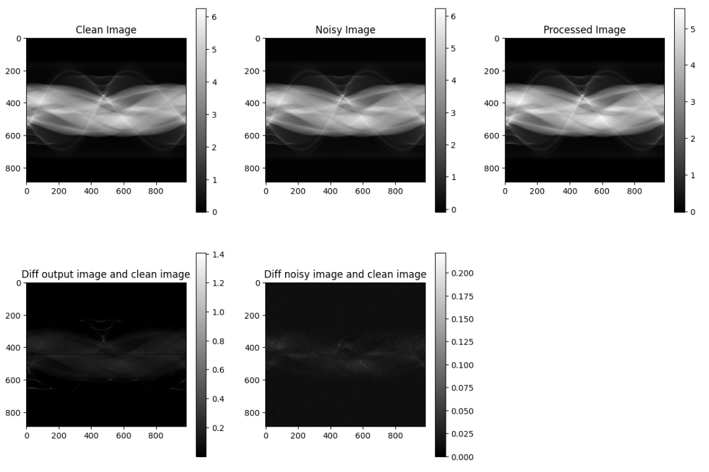

Slide 9
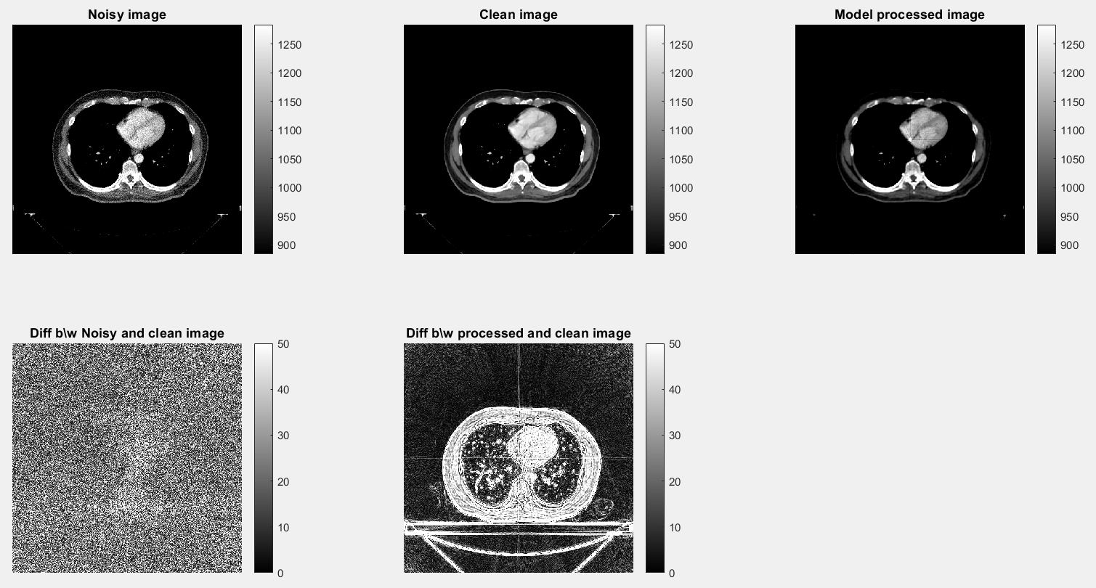

Slide 10
Inferences
One issue we are facing currently is, since the model was trained for sub-images, while combining the sub-image outputs of the model, due to zero padding, we could see a line present there.
Although, we could not spot any circular artifacts due to those lines in the sinogram
A solution to this can be adding a additional zero padded layer to the edges in the input

